Slide 1



AI enabled workforce scheduling for Retail “Nursing problem”
Alexander Snurnitsyn | CEO | AGroup

Slide 2

Nursing problem
Soft constraints’ examples
Nurses’ personal conflict
Laziness of some nurses
Charge nurses
While addressing the problem we must find a solution, which will satisfy the needs of nurses without compromising the objectives of the hospital.
Hard constraints’ examples
Shifts on the same / following day (e.g., no 24-hour duties)
Vacations / Days off
Other legislation constraints:
Specification of shifts (e.g., morning, afternoon, and night)
All patients should have a nursing coverage
Differences in nurses’ qualifications
Ultimately, the optimization of scheduling is to minimize costs while satisfying the demand curve.

Slide 3




“Nursing” in Retail. The case of one Baltic client
?!
Cashier zone
Gastronomy
Shopping room
Warehouse
How to minimize costs while satisfying a demand curve?

Slide 4
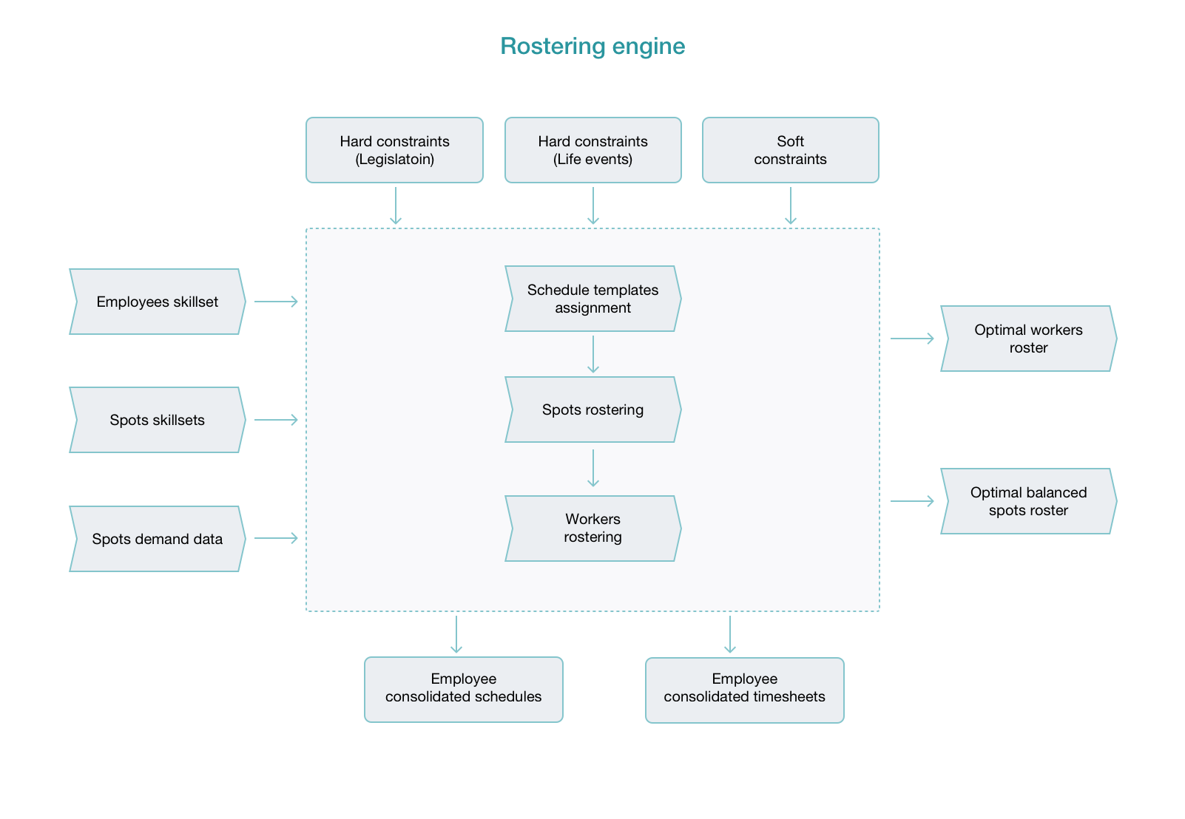
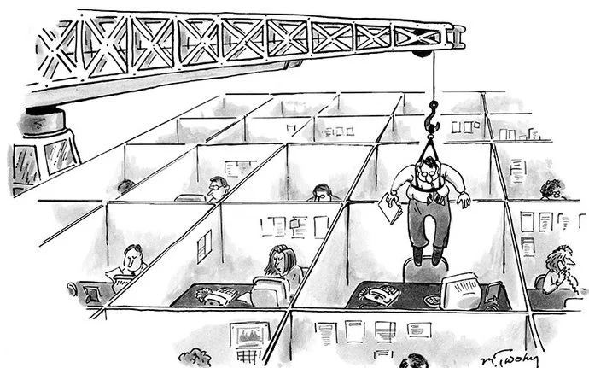


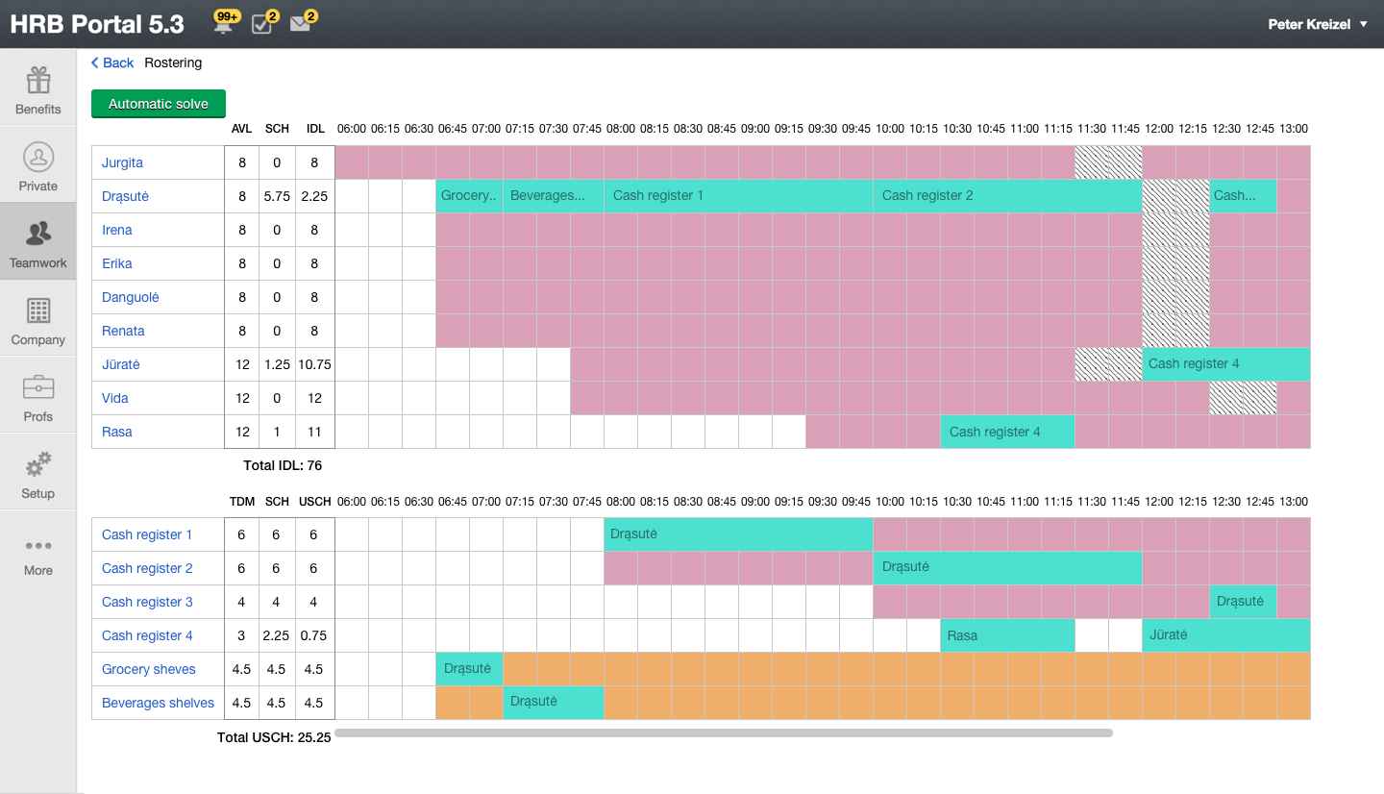

NP-hard problem doesn’t allow a precise math solution
Widely adopted approach
Rostering engine to support decision making
Notes:
Issues for the “classical” approach: - not all hard and soft limitations are taken into account, a suboptimal decision = high costs and lost sales/idle time
Issues with an “advance option” – Typically high cost of foreign solution while a lack of compliance with a local legislation = the most important hard limitations are not taken into account. Those of them who use AI trains it on data of one company only = the limited set of date to train = lower quality of rostering

Slide 5


AGroup and Deloitte aim is to create AI enabled Rostering Solution constantly trained on industry wide and country specific data
Company 1
Company 2
+ AI expertise and experience
+ Clients’ trust
+ Best-of-the-breed cloud HRM solution in Baltics & Poland
AI enabled Rostering Solution
Depersonalized Data Warehouse
Company 3
Company 4
Company 5

Slide 6

AGROUP
AGroup
is a leading HR digitalization service & software provider in Latvia, Estonia, Lithuania & Poland
serves the most reputable employers across multiple industries such as: Telia, Tamro (BENU), Luminor, Ignitis, Drogas, Stockmann, Kesko Senukai, Robert Bosch, etc.
Retail & Production are key verticals
since 2008 HRB Portal has been digitally transforming HR & payroll processes to manage your people with ease & comply with local legislation
AGroup provides payroll & HR outsourcing services on the top of HRB Portal solutions
Your HR digitalization partner
Your HR digitalization partner

Slide 7

Q&A
Thank you for your attention!
info@agroup.lv
www.agroup.lv

